Slide 1
High-Resolution ADC Using Delta-Sigma Architectures
sddec18-20
http://sddec18-20.sd.ece.iastate.edu
Advisor: Professor Randall Geiger
Clients: Professor Randall Geiger and Professor Degang Chen

Slide 2
Problem and Intended Use
Problem
Design a Delta-Sigma Analog to Digital Converter that reads an analog signal from an on-chip temperature sensor and converts it into a digital output
Used in many circuits
Data is normally characterized as an analog signal, converting it to a digital signal allows the signal to be easily manipulated
Thermometer
Music Recording
Voltage Reference
Notes:
Music Recording- people take an analog recording and use an ADC to create pulse code modulation data streams that go into compact discs and digital music files
Band Gap voltage reference – Band gap voltage is a physical constant (independent of temperature, power supply, and circuit loading) to emulate the band gap voltage it is necessary to take the log of the voltage, this can be easily done in a digital space

Slide 3
Requirements and User Interface
Requirements
Functional
Sampling at a rate of 102.4kHz
Temperature range of sensor from 10ºC to 60ºC
10-bit output
Fabricated in TSMC 180nm process
Non-functional
Must fit inside a die of 4mmX4mm
User Interface
IC designers integrate them in IC designs, both in academic and industry
sddec18-20 High Resolution ADC Using Delta-Sigma Architectures

Slide 4
Other Considerations and ADC Designs
Higher order modulator in the Delta-Sigma ADC
Performs noise shaping
Removes the majority of noise and produces a more accurate output
SAR ADC
Faster than Delta-Sigma
Does not practice oversampling
Nyquist Rate ADC
Samples closely to the Nyquist Rate
sddec18-20 High Resolution ADC Using Delta-Sigma Architectures
Notes:
Oversampling- distributes quantization noise over a larger spectrum, decrease quantization noise
SAR- binary search algorithm to converge on an input signal

Slide 5
Delta-Sigma ADC and On-Chip Temperature Sensor
sddec18-20 High Resolution ADC Using Delta-Sigma Architectures

Slide 6
Operating Environment and Familiarity with tools
Operating Environment
It can be implemented into any integrated circuit
There will be pin out between the modulator and the temperature sensor, this will allow us to test any analog signal
Familiarity
Simulations performed in Cadence
The majority of our team has taken EE 435
Entire team has taken EE 330
sddec18-20 High Resolution ADC Using Delta-Sigma Architectures

Slide 7
Deliverables
Fabricated Delta-Sigma ADC through MOSIS
Fabricated on-chip temperature sensor
Assessment of the overall performance of the ADC and the temperature sensor
sddec18-20 High Resolution ADC Using Delta-Sigma Architectures

Slide 8
Project Management
sddec18-20 High Resolution ADC Using Delta-Sigma Architectures

Slide 9
Project Management
Resources
Access to:
Cadence
Fabrication through MOSIS
TSMC180nm files
Pad Frame compliant with 180nm process
Oven
Electrolytic bath
Serial interface Card
Work method: divide work into circuits
Risks
Improper handling or destruction of IC
ESD anti-static wristband
Handle IC with extreme care
sddec18-20 High Resolution ADC Using Delta-Sigma Architectures

Slide 10
System Design Blocks
sddec18-20 High Resolution ADC Using Delta-Sigma Architectures

Slide 11
Clock
A ring oscillator with 23 inverters for the main clock (1638.4kHz)
This splits into 4 clock signals (102.4kHz)
sddec18-20 High Resolution ADC Using Delta-Sigma Architectures

Slide 12
Temperature Sensor
A diode is a temperature dependent device. By fixing the current across the diode the voltage across the diode will change with thermal voltage. The output of the sensor will be the input to the modulator
sddec18-20 High Resolution ADC Using Delta-Sigma Architectures

Slide 13
Modulator
The modulator takes the analog output of the temperature sensor as its input, and outputs a digital signal that contains the temperature data in the form of a data stream whose proportion of 1’s to total values in a 10-millisecond time span is equal to the magnitude of the input voltage to the modulator relative to the input voltage range.
sddec18-20 High Resolution ADC Using Delta-Sigma Architectures

Slide 14
Integrator
The integrator generates a saw tooth wave. The voltage output of the integrator progresses in a negative or positive direction depending on the sign of the input voltage. The slope of this progression depends on the magnitude of the input voltage. The output of the integrator will be the input to the dynamic comparator
sddec18-20 High Resolution ADC Using Delta-Sigma Architectures

Slide 15
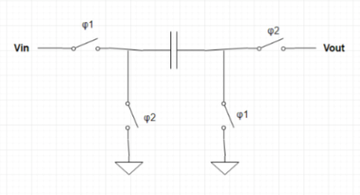
Switched Capacitors
Non-Inverting
Inverting
sddec18-20 High Resolution ADC Using Delta-Sigma Architectures

Slide 16
Dynamic Comparator
The output of the integrator will enter V_{in+} and be compared to a voltage reference at V_{in-} .If V_{in+} is larger the output will be VDD, if not it will be VSS. This decision will be made at a clock edge. The output of the comparator will be the input to the Decimator and DAC
sddec18-20 High Resolution ADC Using Delta-Sigma Architectures

Slide 17
DAC
The DAC takes a digital input from the output of the comparator and converts it into an analog signal to be applied to the input of the integrator.
sddec18-20 High Resolution ADC Using Delta-Sigma Architectures
Notes:
The DAC works using a switched capacitor with Vref+ connected to the input. By using the output of the comparator to control the clocking of the switched capacitor via two multiplexers, a positive or negative current is applied at the DAC’s output depending on the output level of the comparator. By configuring the control switching appropriately, the modulator’s differencing block is also implemented by the DAC.

Slide 18
Decimator
The decimator's function is to convert the binary data stream applied to its input by the modulator to a lower-frequency 10-bit parallel output.
sddec18-20 High Resolution ADC Using Delta-Sigma Architectures
Notes:
This is done by summing the inputs over 1024 clock cycle time spans and asserting these sums at its output. This results in a new output code every 10 milliseconds. The summing is accomplished by a 10-bit counter. The sum is then loaded to a 10-bit output register after every 1024 clock cycles, at which point the counter is reset. The loading of the register and resetting of the counter is controlled by another 10-bit counter which acts as a clock divider of the 102.4 kHz system clock.

Slide 19
Test Results
sddec18-20 High Resolution ADC Using Delta-Sigma Architectures

Slide 20
Modulator Simulation
Plotted output was integrated over 100 milliseconds
The behavior of the modulator should be that the proportion of the time that the output is high should be equal to the magnitude of the input voltage to the modulator relative to the input voltage range.
sddec18-20 High Resolution ADC Using Delta-Sigma Architectures

Slide 21
Overall Results
The desired output is a 10-bit code on 10 parallel output pins, whose magnitude is proportional to the proportion of the input values that are high in a 10ms timespan. A new code should be output every 10ms.
sddec18-20 High Resolution ADC Using Delta-Sigma Architectures

Slide 22
Next Steps and Conclusions
sddec18-20 High Resolution ADC Using Delta-Sigma Architectures

Slide 23
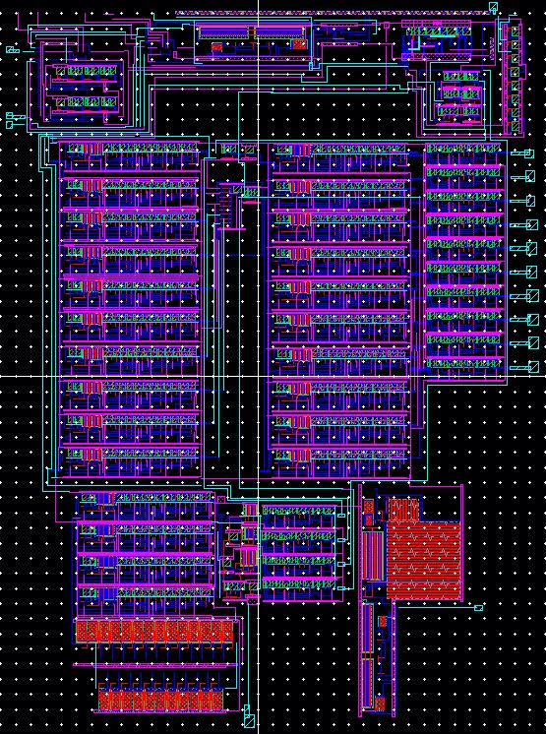
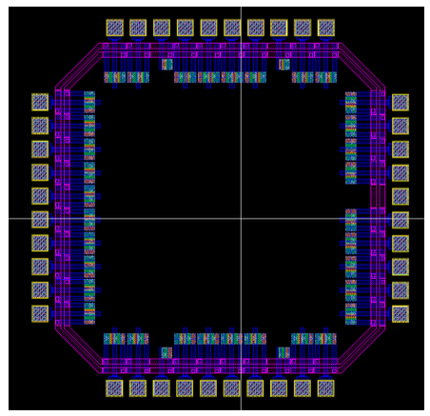
The Following Weeks
Parasitic capacitances will be extracted
Post layout simulations will be run to ensure the circuits functionality
The layout will be turned over to MOSIS for fabrication
sddec18-20 High Resolution ADC Using Delta-Sigma Architectures

Slide 24
Next Semester and Contributions
the ADC will be tested using the lab equipment and a serial interface card. DC power supplies will be used to provide the proper biasing voltages to the IC, and the serial interface card will be used to link the ADC’s 10-bit parallel output to a computer to collect output data
The Temperature sensor will be tested by
Placing it in an oven
Placing it in an electrolytic bath
Circuits divided throughout team members
We are on schedule!
sddec18-20 High Resolution ADC Using Delta-Sigma Architectures
Notes:
ADC Testing: The output of the temperature sensor will be connected to the input of the ADC, and we will use the known output voltage characteristics of the sensor to provide a variety of known voltages to the ADC by adjusting the temperature of the IC in an oven or dielectric bath. The outputs from the ADC will be recorded for a variety of input voltages, and these measurements will be compared to those obtained through Cadence simulations. We will also use this data to extract a variety of characterization parameters for the ADC, such as monotonicity, differential nonlinearity, and integral nonlinearity.
Testing Temp. Sensor: Tested with one of two methods. The first is with an oven. The chip will be placed on a breadboard which will be placed in an oven. A multimeter probe will be connected to the temperature sensor’s output pin through the porthole in the oven. The oven’s temperature will then set to a variety of temperatures within the 10 to 60-degree Celsius range. At each temperature, the sensor’s output voltage will be measured with the multimeter and recorded. These measurements will then be compared with the Cadence simulation results.
The second method: merge the IC in an electrolytic bath. The bath consists of a vessel containing an electrolytic liquid which is heated to a well-controlled temperature. The output voltage will then be measured with a multimeter probe at a variety of temperatures.

Slide 25
Thank you!
Caroline Alva
Tyler Archer
Caleb Davidson
Mahmoud Gshash
Josh Rolles
sddec18-20 High Resolution ADC Using Delta-Sigma Architectures

Slide 26
Clock outputs

Slide 27
Temperature Sensor Output

Slide 28
Integrator Output

Slide 29
Dynamic Comparator

Slide 30
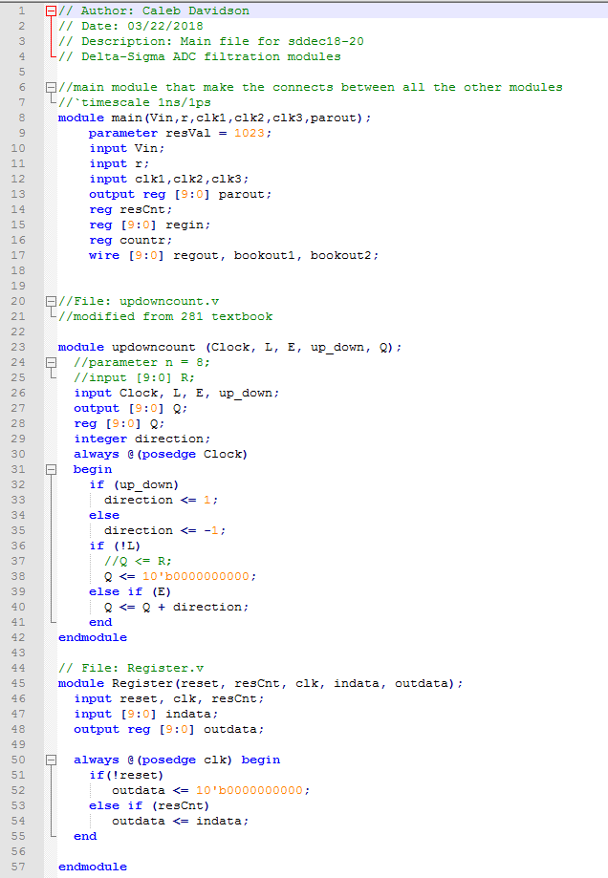
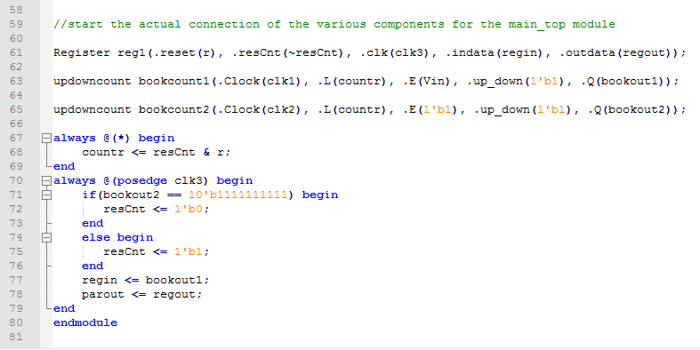
Counter-based Decimator Verilog

Slide 31
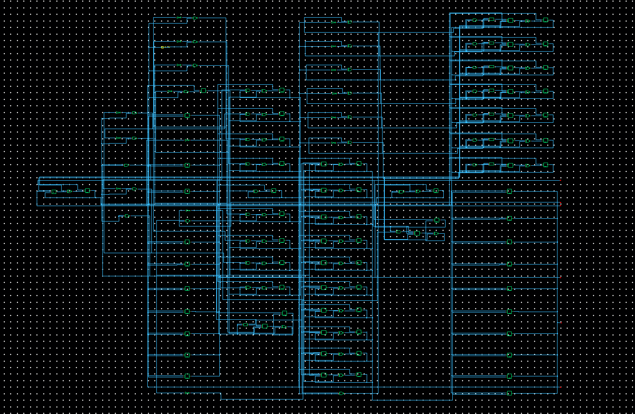
Counter-based Decimator Schematic

Slide 32
Counter-based Decimator Verilog Layout

Slide 33
Initial Decimator Design Strategies
Researched the theory and FIR filter structure that generally constructs the low pass and decimation filtration.
Initial thought process was to build a design centered around summating impulse responses of the input signal, but this was soon found to be a not effective or efficient path to take.
The Sinc filter of orders 1, 3, and 5 were considered as their frequency response fits the characteristics of the theory behind the decimator filter. Sinc filter of order 1 was considered due to its lessened difficulty to implement where we did not need the added complexity of orders 3 or 5.
Even further the complexity of a Sinc order 1 filter proved to be more than needed in our output, and in order to design efficiently we chose a simpler counter-based structure for decimation. This provides less noise shaping effects than other structures.

Slide 34
Decimator Unit Testing
Tested output when 50%, 75%, and 25% duty cycles. All outputs matched the input from an ideal input voltage, and for multiple output codes given the same input cycle.
Tested high-frequency input with a 50% on, 50% off system, but where on is for one clock cycle and off is for one clock cycle.
Modulator integration was tested with a full modulator input data. This led to accurate results with each of the above test cases for multiple output codes.

Slide 35
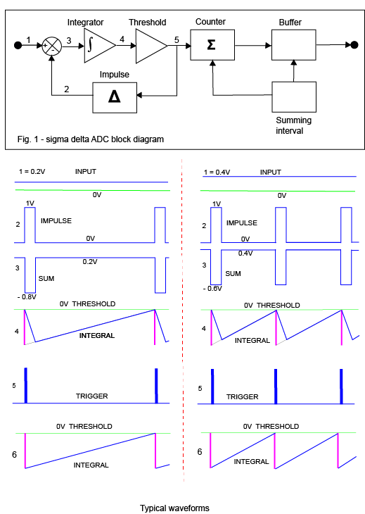
How the Decimator Integrates into the Design
The Sigma component of the delta-sigma architecture is our 10-bit counter reading values from the modulator.
Another counter acts as our summing interval.
The register acts as a buffer holding one output code per 1024 inputs from the modulator.

Slide 36
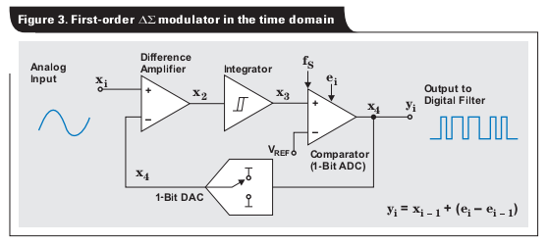
Modulator Diagram

Slide 37
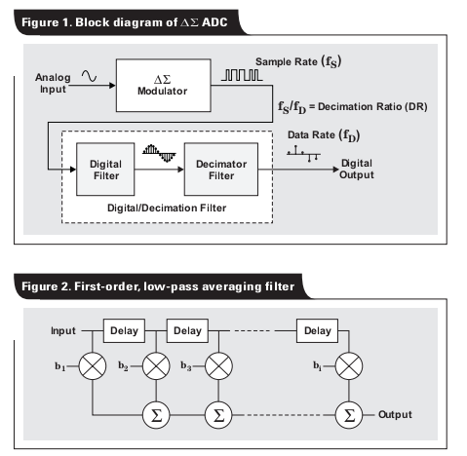
Overview Level Diagram with Averaging Filter Design

Slide 38
Sinc 3rd Order Example Filter Design

